Slide 1
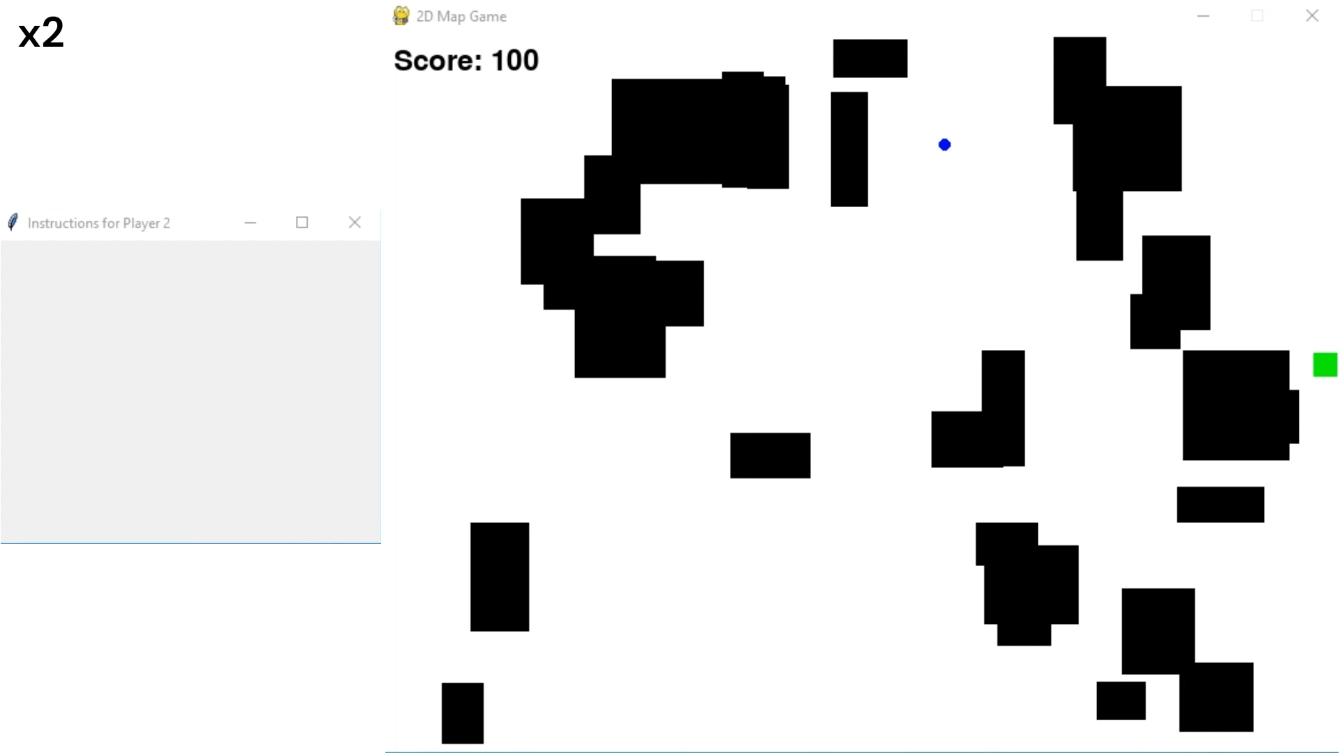
Offline Reinforcement Learning-Based Human Guide Robot for Visually Impaired Navigation
Anushka Deshpande, Gil Gur-Arieh and Hadar Hai
CS236006

Slide 2
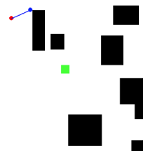
Introduction & Problem Statement
Offline Reinforcement Learning-Based Human Guide Robot for Visually Impaired Navigation
Problem Overview: Investigating the challenge of guiding a visually impaired individual through a 2D obstacle map using a guide AI-robot.
Scenario Example: A guide robot (red) leads a human (blue), connected by a leash, towards a goal (green) while avoiding obstacles.
Research Contributions: Formulation of a new problem, development of a novel solution approach, and establishment of formal guarantees.
Methodology & evaluation
Approach: Utilizing Offline Reinforcement Learning with human-human interaction data to train a guide AI-robot agent.
Dataset & Setup: Collection of human-human interaction data in a simulated interactive environment to train the agent.
Results & Conclusion: Empirical evaluation of the agent's success in guiding the visually impaired and discussion of the method's limitations.

